Slide 1
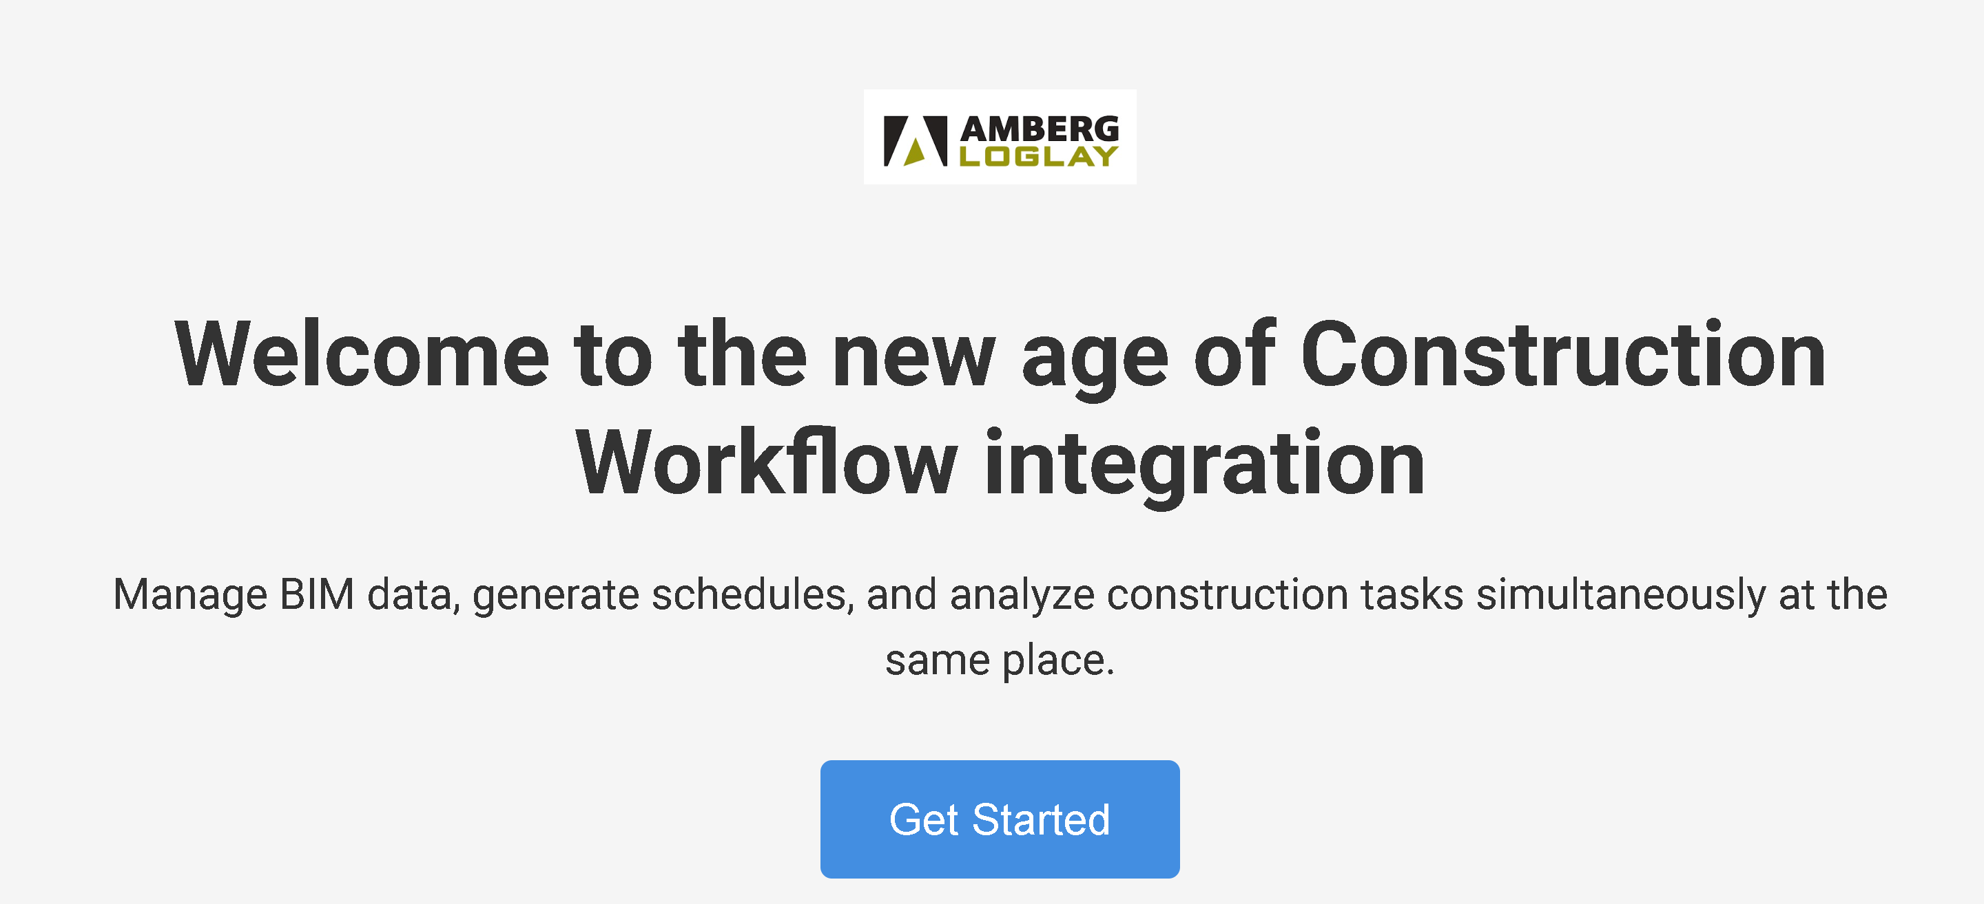
Construction Management BIM-Based Service

Slide 2
Functionalities:
BIM Data Analysis
Feature Predictor
BIM - Construction Based Schedule Generator
BIMChat

Slide 3

Input 3D Model…
File Upload Process:
The user can upload his data or ifc model to the site, the files is saved and fed to the pipeline.
The type of files uploaded can be only ifc or bim data as tabular data (xlsx

Slide 4

Input 3D Model…
Supported File Types
.ifc, .xlsx

Slide 5

Preprocessing step
Cleaning, Removing unnecessary features, find features with significant information

Slide 6
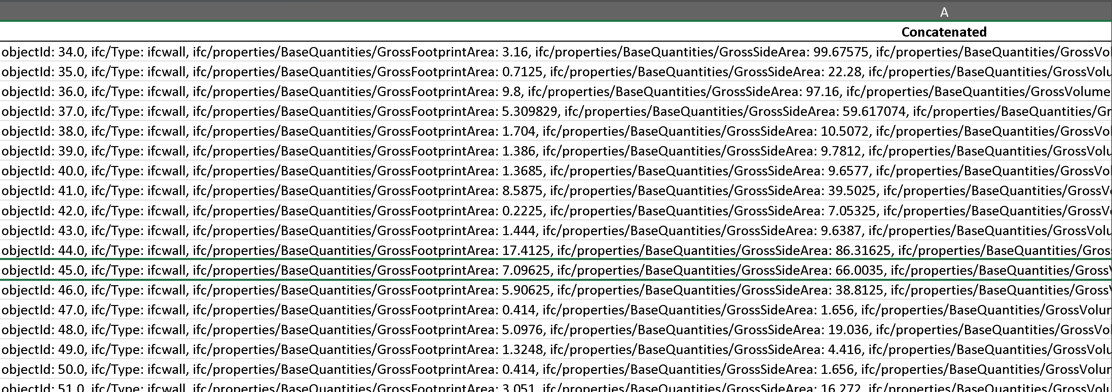
Concatenation
The data are concatenated to create a compressed text for each object in the 3D Model

Slide 7
Key Functions: EBKP Analysis:
Get automatically the EBKP categories of any given BIM Data file or dataset
Get analytics for the categories
Find missing categories compared to predefined schedules

Slide 8
Volume Analysis:
Aggregation of volumes by EBKP categories.
Breakdown of quantities by materials (e.g., concrete, steel).
Material Analysis:
Listing of materials used in BIM data with their quantities.
Potential Cost Analysis:
Linking material quantities and EBKP categories to predefined cost databases.
Estimation of costs per discipline or task.

Slide 13
Feature Predictor:
For each object we can predict:
Duration: Estimated time to complete.
Dependencies: Preceding tasks required for execution.
Cluster: Related construction domain (e.g., Mechanical, Electrical).
Materials: Resources required for the task, (can be used for scheduling)
4D Relevant: Indicates tasks critical for the 4D BIM model.
EBKP Categories: Classification based on predefined standards.
Interactive Features:
Generate and view Gantt charts dynamically.
Identify gaps between BIM data and predefined schedules.

Slide 14
Schedule Generator
Discipline-Specific Tasks: The tool organizes tasks based on predefined schedules disciplines (e.g., Mechanical, Electrical, Plumbing).
Example:
Tasks include duct installation, piping, and insulation.
Dependencies are clearly defined (e.g., "Laying of ductwork" depends on "Installation of duct supports").
Ensures that tasks are logically connected, reducing clashes in execution.

Slide 15
Dynamic Visualization:
Tasks are displayed in a sequential Gantt chart.
EBKP categories are used as labels on bars.
Additional Features:
Adjust durations and dependencies interactively.
Color-coded bars for each discipline or material.

